Slide 1
9.4 Slope-intercept form of Linear Equation

Slide 2
Reviews of Previous Classes
Equation: B=3A

Slide 3
the intersection of y-axis and the straight line
x=0, y=b
as ordered pair (0,b)
y-intercept
y=mx+b
Slope
(0,10)
v =-2t+10
t=0, v=10

Slide 4
Class 1 Example 2: The graph shows the total distance travelled in relation to the time spent to travel
Time (second), t | Distance 1 (meter), D1 | Distance 2 (meter), D2
1 | 3 | 5
2 | 6 | 10
3 | 9 | 15
4 | 12 | 20
5 | 15 | 25
6 | 18 | 30
$$\frac{Distance 1 (meter)}{Time (second)}=\frac{3}{1}=3 meter/second$$
D1=3 t
$$\frac{Distance 2 (meter)}{Time (second)}=\frac{5}{1}=5 meter/second$$
D2=5 t
y=mx
D3=100 t
Tool Box
Notes:
(1) Verbally slope indicates the steepness of a line (the sign indicates direction and the absolute value describes the steepness -- the larger the absolute value the steeper the graph.) This is related to the grade of a hill or the pitch of a roof.
(2) Algebraically slope is typically represented by m: for instance the equation of a line can be written as y=mx+b where m represents the slope. Also the slope formula where . However, some linear functions use other letters for the value that is the slope of the graph such as a direct variation y=kx where k is the constant of proportionality.
(3) Graphically slope is often represented as rise over run, or , or the ratio of the change in the vertical direction to the change of the horizontal.
(4) In modelling situations we say that the slope is the constant (or average) rate of change.

Slide 5
v =-2t+10
y=mx+b
m=
-2
v =-2t+10 m=-2
v =-t+10
m=-1
v =-5t+10
m=-5
Tool Box

Slide 6
the cross-point of y-axis and the straight line
x=0, y=b
as ordered pair (0,b)
y-intercept
y=mx+b
Slope
Rate of Change
m>0, y-value increase, the greater m is, the faster y increase /the steeper the straight line
m=0, y is constant/does not change
m<0, y-value decrease, the smaller m is, the faster y decrease /the steeper the straight line
m is undefined, x=constant
It measures(shows) how fast y-value changes with the changes of x-value

Slide 7
Desmos Play Time
Create lines:
y=x y=-x
y=2 y=-2
x=2 x=-2
y=3x+5 y=3x-5
y=-3x+5 y=-3x -5

Slide 8
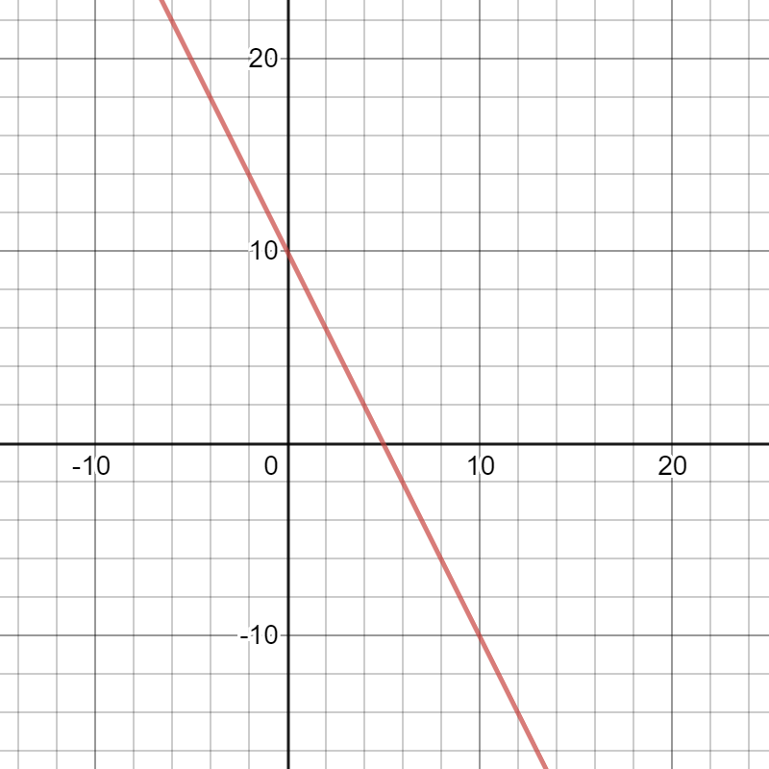
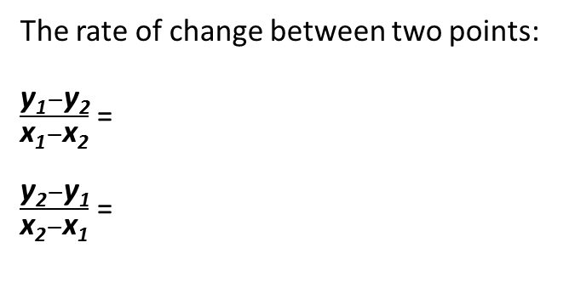
y
The rate of change between two points:
$\frac{\text{y}\text{1}−\text{y}\text{2}}{\text{x}\text{1}−\text{x}\text{2}}$ =
$\frac{\text{y}\text{2}−\text{y}\text{1}}{\text{x}\text{2}−\text{x}\text{1}}$ =
(0,10)
b=10
slope m
(x₁,y₁)
(x₁,y₁) and (x₂,y₂)
are any two different points on the line
x
$m=\frac{\text{y}\text{1}−\text{y}\text{2}}{\text{x}\text{1}−\text{x}\text{2}}$ = $\frac{\text{y}\text{2}−\text{y}\text{1}}{\text{x}\text{2}−\text{x}\text{1}}$
(x₂,y₂)
(x₁,y₁)
(2,6)
(x₂,y₂)
(10,-10)
y=mx+b
$m=\frac{6−(−10)}{2−10}$ =$\frac{−10−6}{10−2}$=-2
y=-2x+10

Slide 9
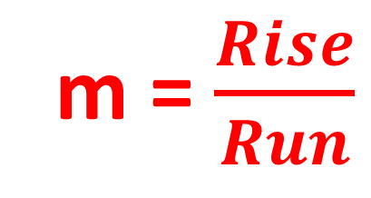
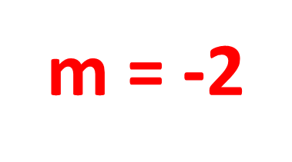
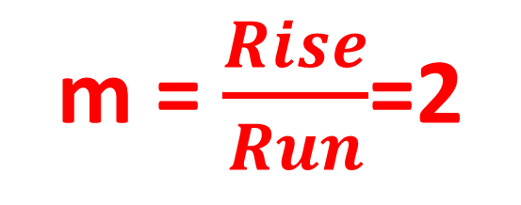
The rate of change between two points:
y
m =$\frac{Rise}{Run}$
Run
Determine the sign + or -of slope!!!!!!
x
Rise
m =$\frac{Rise}{Run}$=2
m = -2

Slide 10
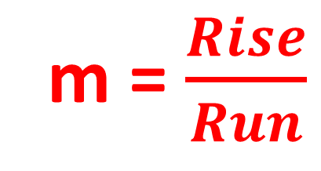
In summary: calculate slope m
y
(x₁,y₁) and (x₂,y₂)
are any two different points on the line
$m=\frac{\text{y}\text{1}−\text{y}\text{2}}{\text{x}\text{1}−\text{x}\text{2}}$ = $\frac{\text{y}\text{2}−\text{y}\text{1}}{\text{x}\text{2}−\text{x}\text{1}}$
(x₁,y₁)
OR
x
m =$\frac{Rise}{Run}$
Rise
Run
(x₂,y₂)
Count the divisions between two points
Determine m is + or -

Slide 11
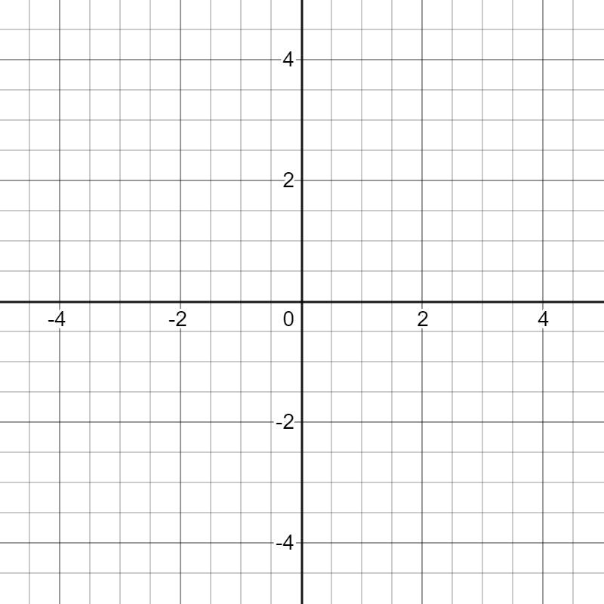
b) y=$\frac{2}{3}$x+1
y
Look for y-intercept:
(0,1)
Look for the 2nd point:
Calculation way:
Let x=3
y=$\frac{2}{3}$3+1 = 3
(3,3)
x

Slide 12
b) y=$\frac{2}{3}$x+1
y
Look for y-intercept:
(0,1)
Look for the 2nd point:
Calculation way:
Let x=
y=$\frac{2}{3}$ +1 = 3
(3,3)
x
3
x

Slide 13
b) y=$\frac{2}{3}$x+1
Look for y-intercept:
(0,1)
y
Look for the 2nd point:
Rise and Run
The slope is $\frac{2}{3}$ = $\frac{Rise}{Run}$
Run is 3: count 3 units along the direction of x-axis
Rise is 2: count 2 units up or down along y-axis
(3,3)
x

